Slide 1

Exploratory/Descriptive Analysis of Iowa home sales
By: Annalee Beck

Slide 2
Predictors of Home Sale Median Price
There are 7 variables that seem to be strong predictors of the “Above_Median” variable, which tells us if a house was sold above or below the median price
The 7 variables we will look at are:
Year built- newer homes will usually always sell above the median home price – show line graph for this
-Overall quality of house
-Sale condition of house
-Kitchen quality
-Month of sale
-Neighborhood

Slide 3
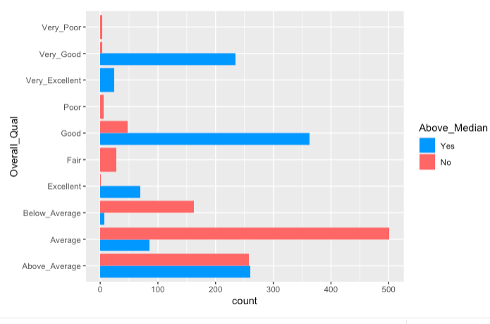
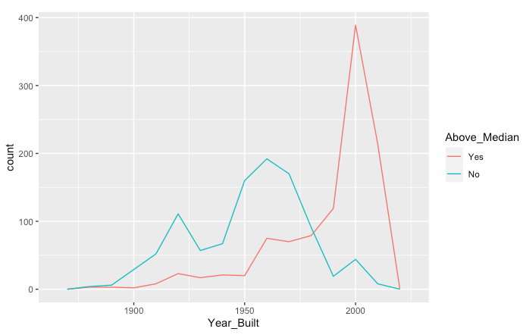
Predictor Variables: Assumed
1.1
1.2
Out of the 8 predictor variables, there are 3 that are usually assumed when we look at what may affect house price- The year the house was built(figure 1.1), overall quality of the house(figure 1.2), and sale condition of the house(figure 1.3).
We see in figure 1.1 that most houses with “good” and “very good” overall quality mostly sell above the median sale price. In figure 1.2, it is apparent that houses start to sell above the median home price the newer they are.

Slide 4
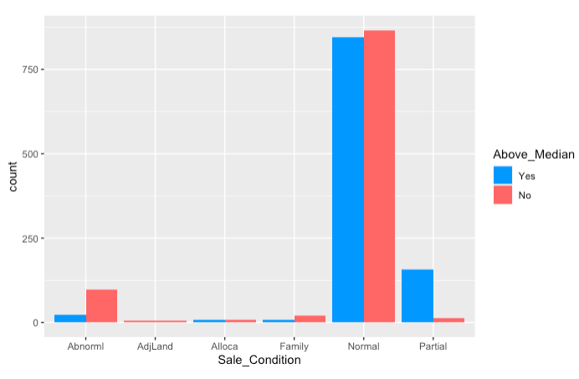
We see that more houses sold under Abnormal conditions (trade, foreclosure, short sale) sold below the median price, while most homes under Partial condition (associated with new homes) sold above the median price (figure 1.3)
Predictor Variables: Assumed (Cont’d)
1.3

Slide 5
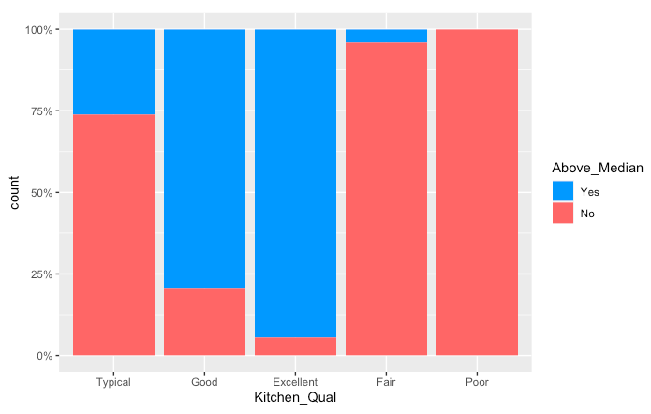
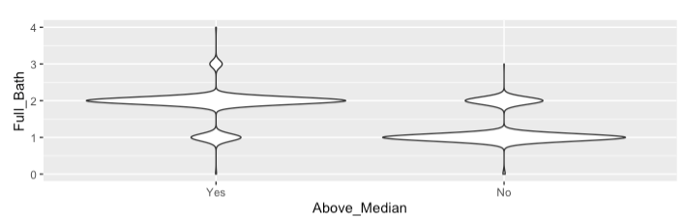
Other Predictor Variables
Here we see the median price of home sales is significantly higher when a home has more than 1 full bath (figure 1.4)
1.5
by looking at the count of kitchen quality in homes as a proportion percentage, we have a better grasp at how influential kitchen quality can be (figure 1.5).
1.4

Slide 6
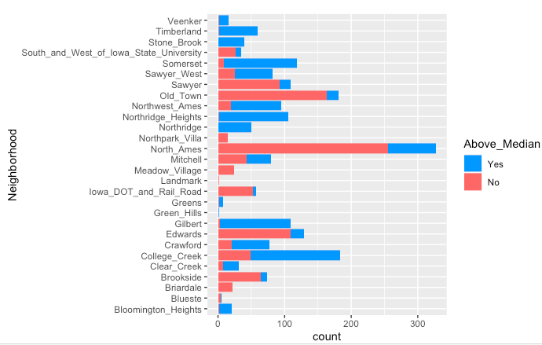
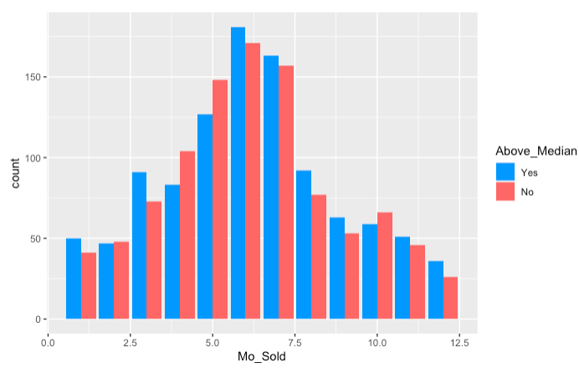
Other Predictor Variables (Cont’d)
We can see trends in median sale price of houses by looking at the months they were sold (figure 1.7). The months are labeled as numbers- 1 for January, 2 for February, etc.
1.6
From figure 1.6, we can easily see how many houses sold above or below the median price in each neighborhood
1.7

Slide 7
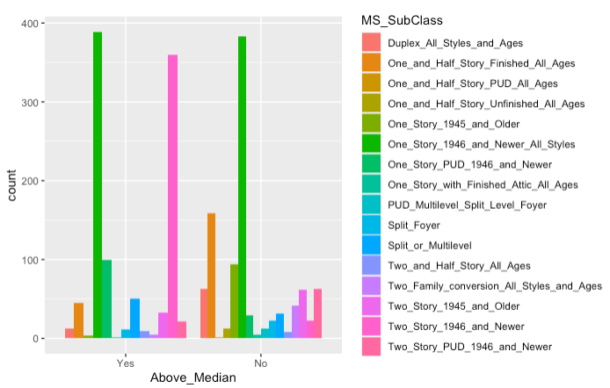
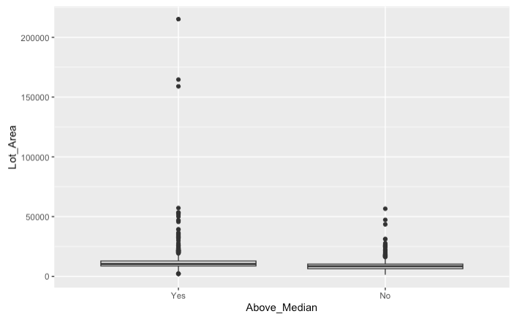
Interesting finds
While originally thinking that the square footage of a house (Lot_Area) would be a strong predictor variable, we can see from this boxplot that it is not. (figure 1.9)
1.8
While this graph of MS_Subclass does show us that most Two-Story Homes built in 1946 and newer sold above the median home price, it shows that One-Story Houses from 1946 and newer both sold almost equally for above and below the median home price. (Figure 1.8)
1.9

